Slide 1

Sports Betting with Data Science
By Justin Tunley

Slide 2
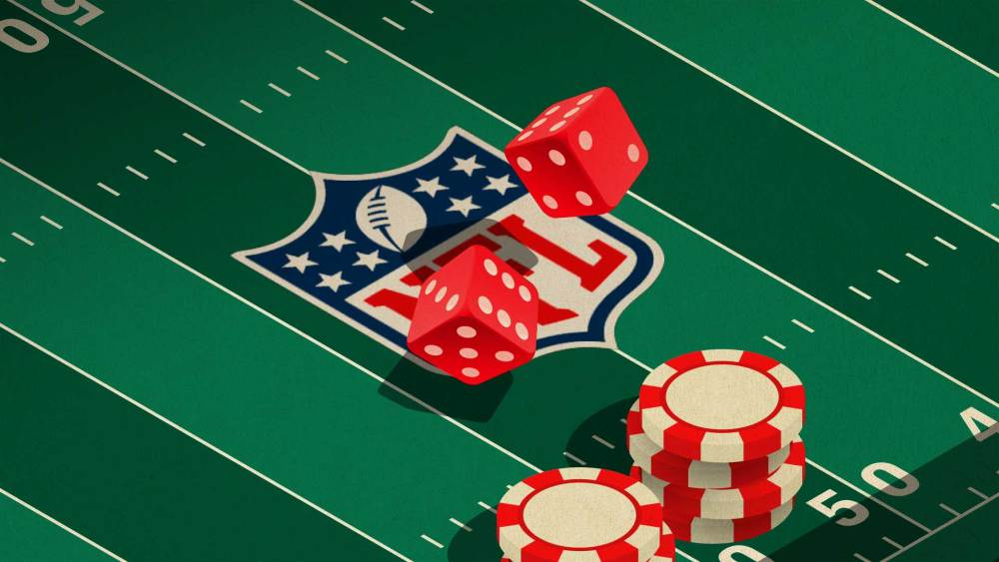
Problem Statement
How can we more accurately predict the outcome of NFL football games using advanced game analytics?

Slide 3
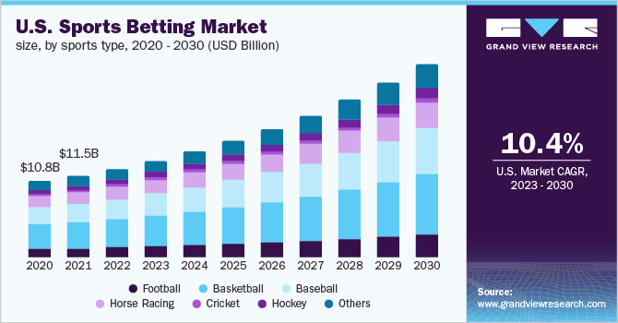
Opportunity and Impact
Opportunity
Online Sportsbooks
Create accurate lines that can help you make money
Household Bettors
Beat the system by finding advantageous bets
NFL Analytics Departments
By understanding what actions translate into points scored, teams can make decisions that give them a better chance of winning.
Impact
Make people money!
Source: Grand View Research

Slide 4
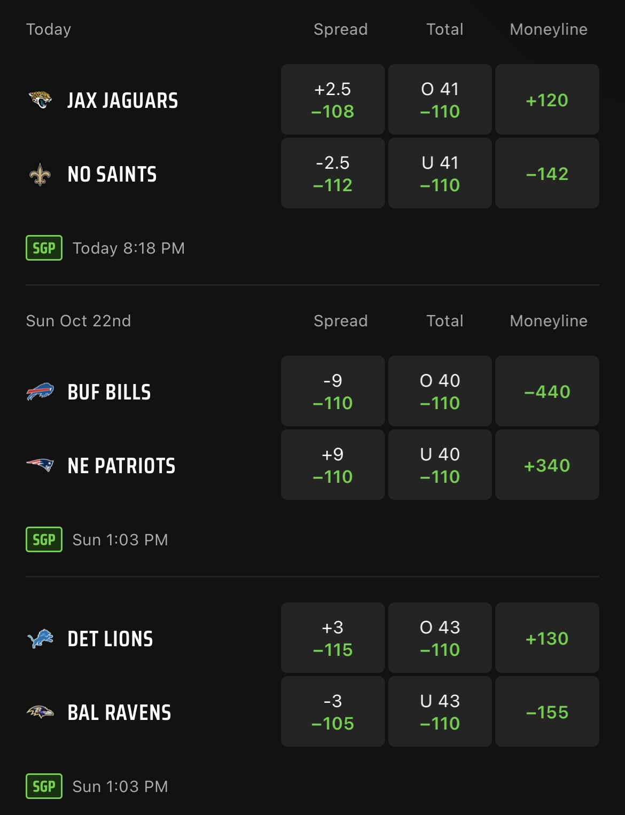
Intro to Sports Betting
Key Terms
Moneyline: Who will win?
Compare expected points between home and away teams.
Spread: How much should the favored team win by?
The difference in expected points between teams.
Point Total (O/U)
The sum of expected points for both teams.
Solving with Data Science
3 Regression models:
Expected Points for home team
Expected Points for away team
Expected Points for BOTH teams

Slide 5
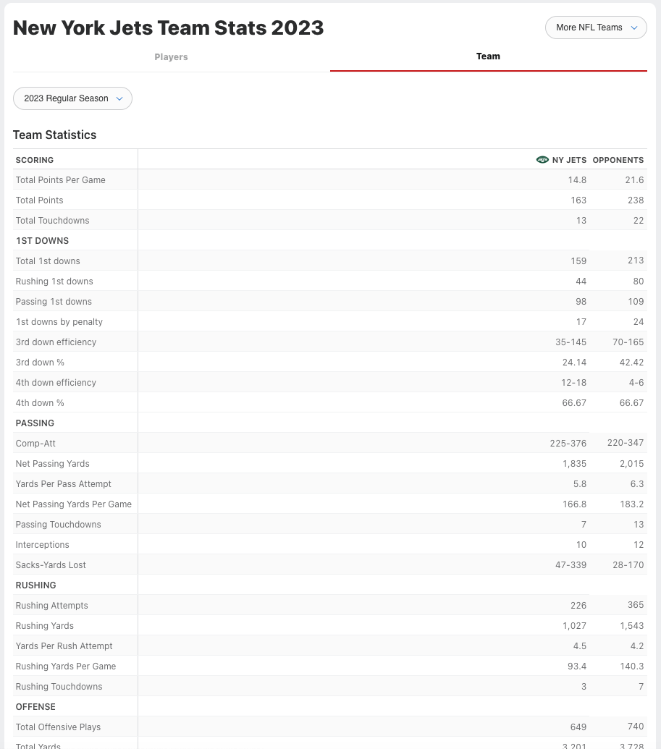
Datasets and Preprocessing Approach
Datasets
Historical Team Data
Scraped from ESPN website
Every team in every year since 2004 (excluding playoffs)
Current-Season Team Data
Scraped from ESPN website
Individual Game Data
Outcomes, locations, weather and stadium data
Methodology
Scrape team statistics from a previous seasons on offense and defense.
Consolidate rows so one row is associated with one team in a particular season.
Create a new data frame with every conceivable matchup between teams in a season.
Merge game outcome data with all matchups that actually happened.
Remove rows where a matchup never occurred and train model to predict future outcomes based on current-season team data.
Import current-season data in same format and run to find predictions.

Slide 6
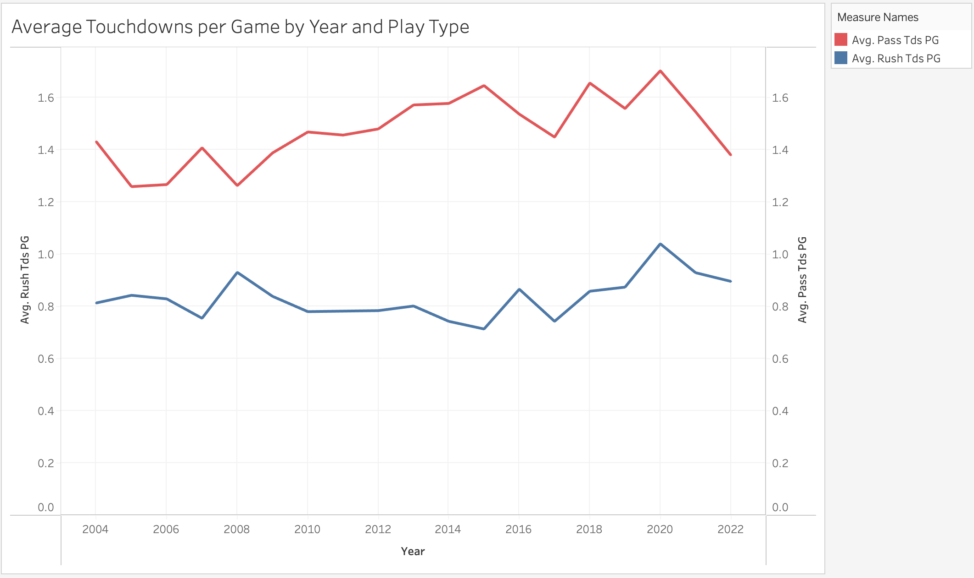
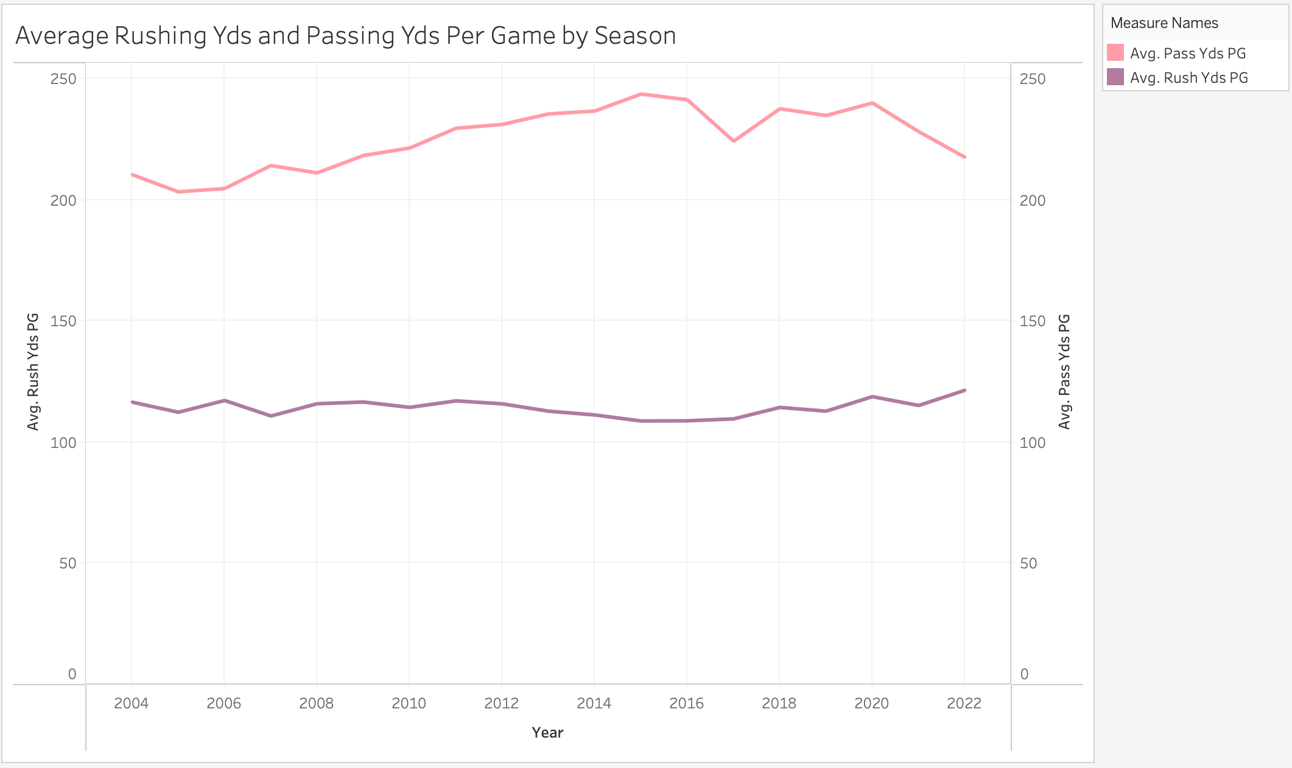
Key Findings: Changes in NFL Scoring Trends
Teams that are pass-heavy are much more likely to score more points than teams that are run-heavy. This does not mean they are more likely to win the game, only that they should be weighed differently when modeling for expected points.

Slide 7
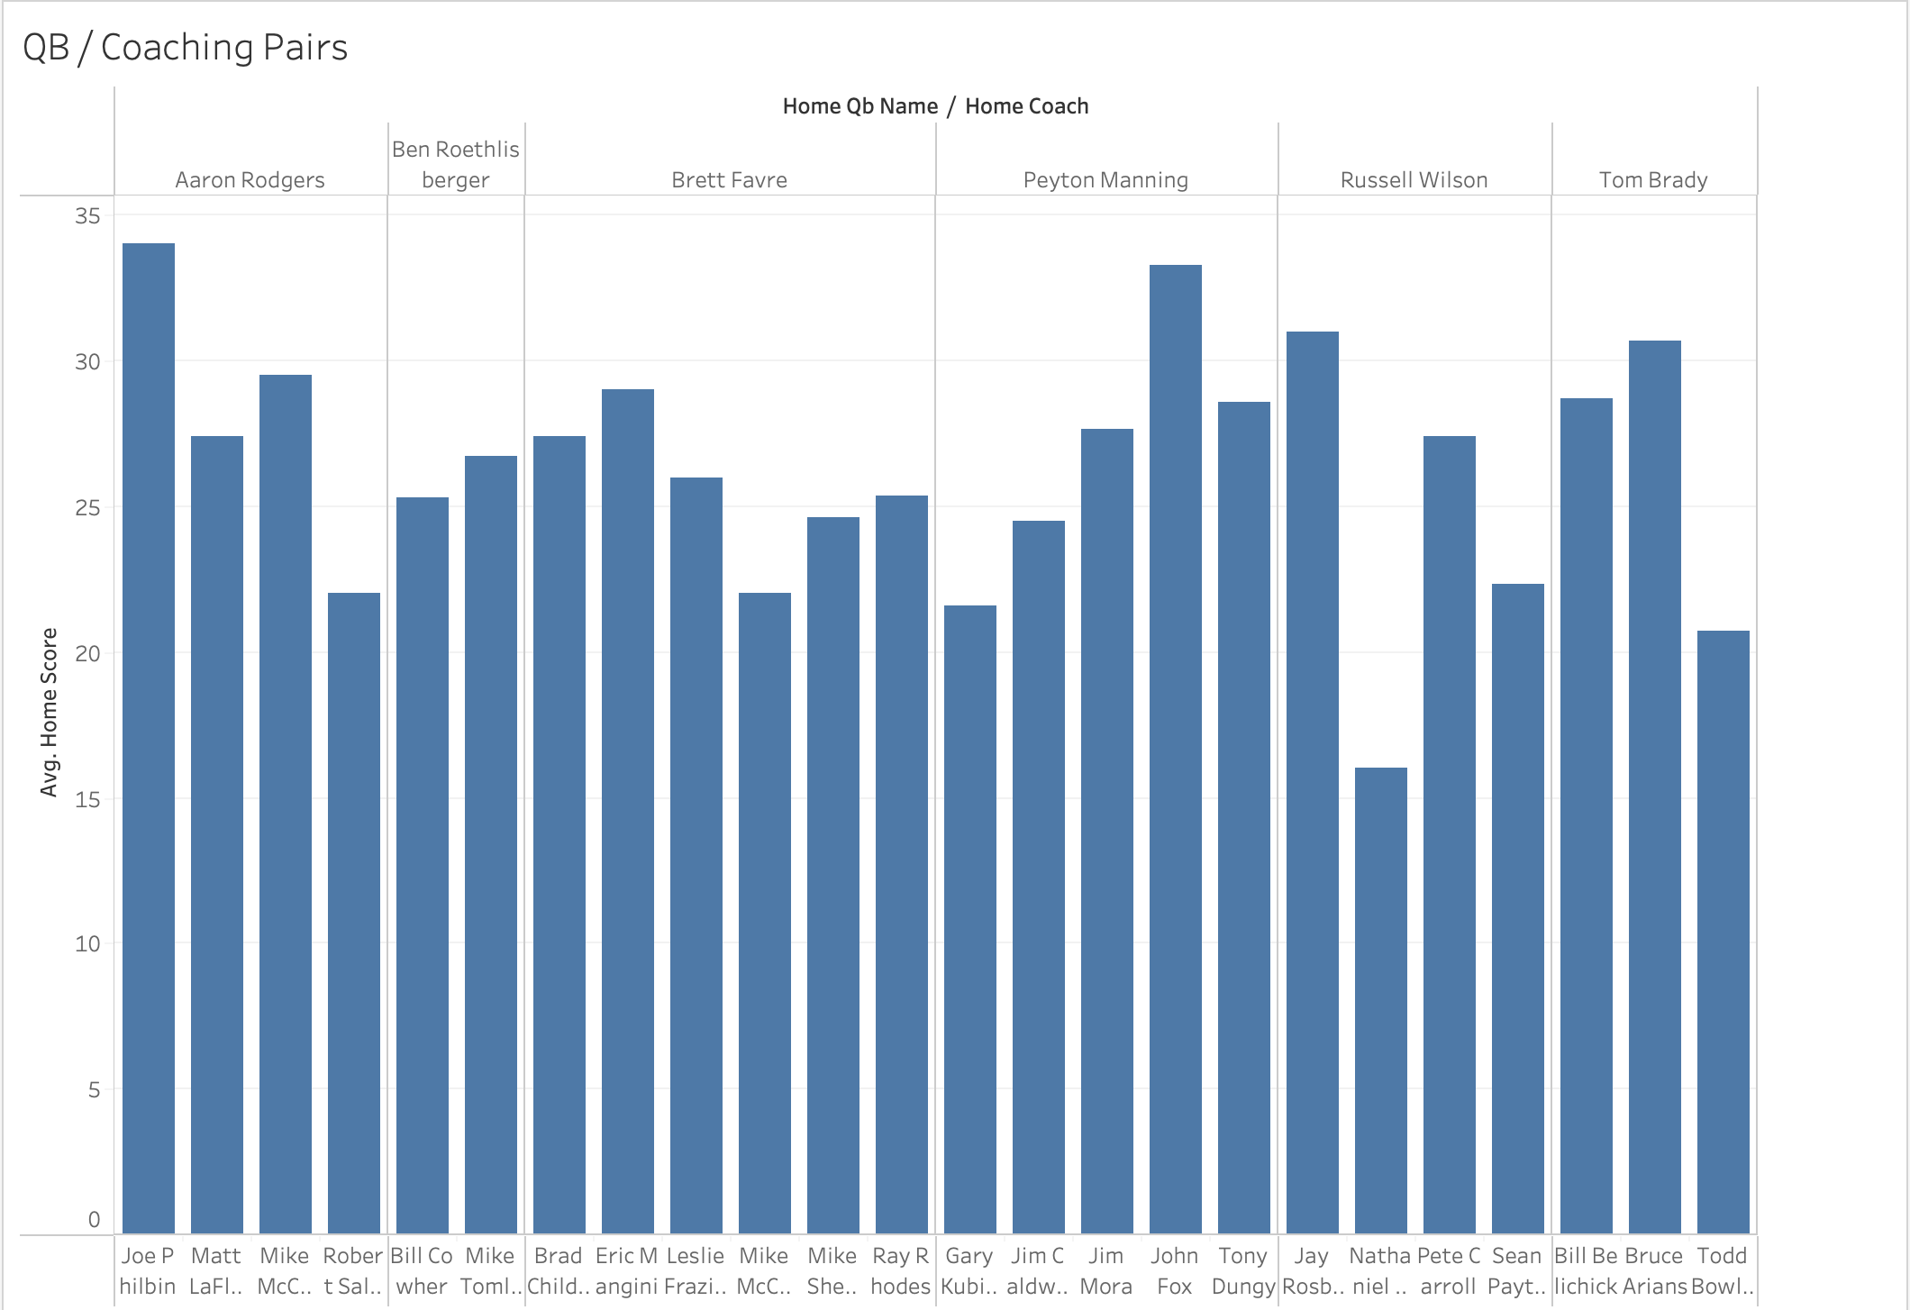
Key Findings: Predictors of an Excellent Team
What do all the best offenses have in common?
A great quarterback
A great head coach
Notable takeaways:
Quarterbacks that spend more time with a single coach tend to perform better.
Even the best quarterbacks cannot succeed without a coaching staff that supports their style of play.
Coaches should focus on creating a system that will work long-term, and give them at least 3 years.

Slide 8
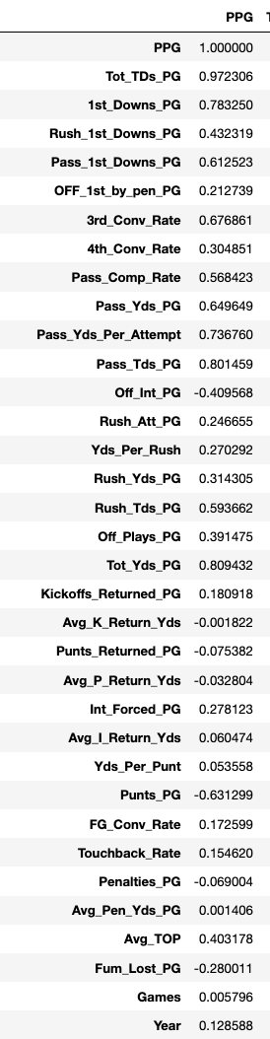
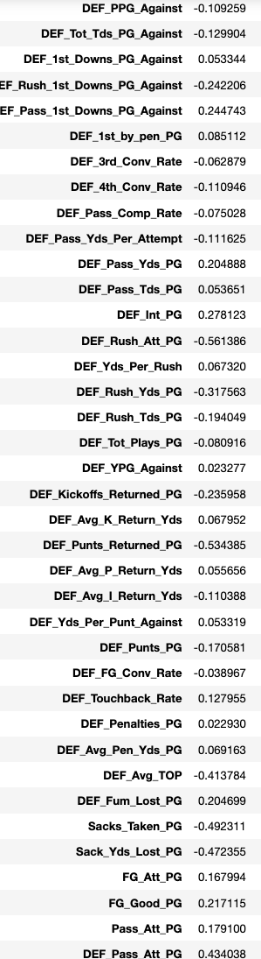
Key Findings: Feature Correlation
Which features are most correlated with Point Per Game?
Closer to 1 means positive correlation, closer to -1 means negative.
Offense:
Total touchdowns: 0.97
Pass touchdowns: 0.80
Total 1st downs: 0.78
Passing yards per attempt: 0.73
Passing 1st downs: .61
Total yards per game: .81
Defense:
Opponent Rushing Attempts per game: -0.56
Opponent Time of Possession: -0.41
Opponent Rushing Yards per game: -0.32
Sacks per Game: 0.29

Slide 9
Key Findings: The Pointlessness of Special Teams
Fans and players argue that special teams isn’t very important throughout the game. Is there merit to this claim?
Touchback Rate: Positive correlation with PPG
Teams that don’t return kickoffs score more points on average.
Kick and Punt Return Yards: Negative correlation with PPG
Teams that do return the ball more score less points on average.
Field Goal Conversion Rate: Positive correlation with PPG
Teams that convert more field goals score more points on average.
Special teams does impact the game in a large way, but in a different way than people expect. It is better to fair catch on kickoffs and punts, but field goal kickers are a very important aspect of the game.
Myth: Kind of Busted

Slide 10
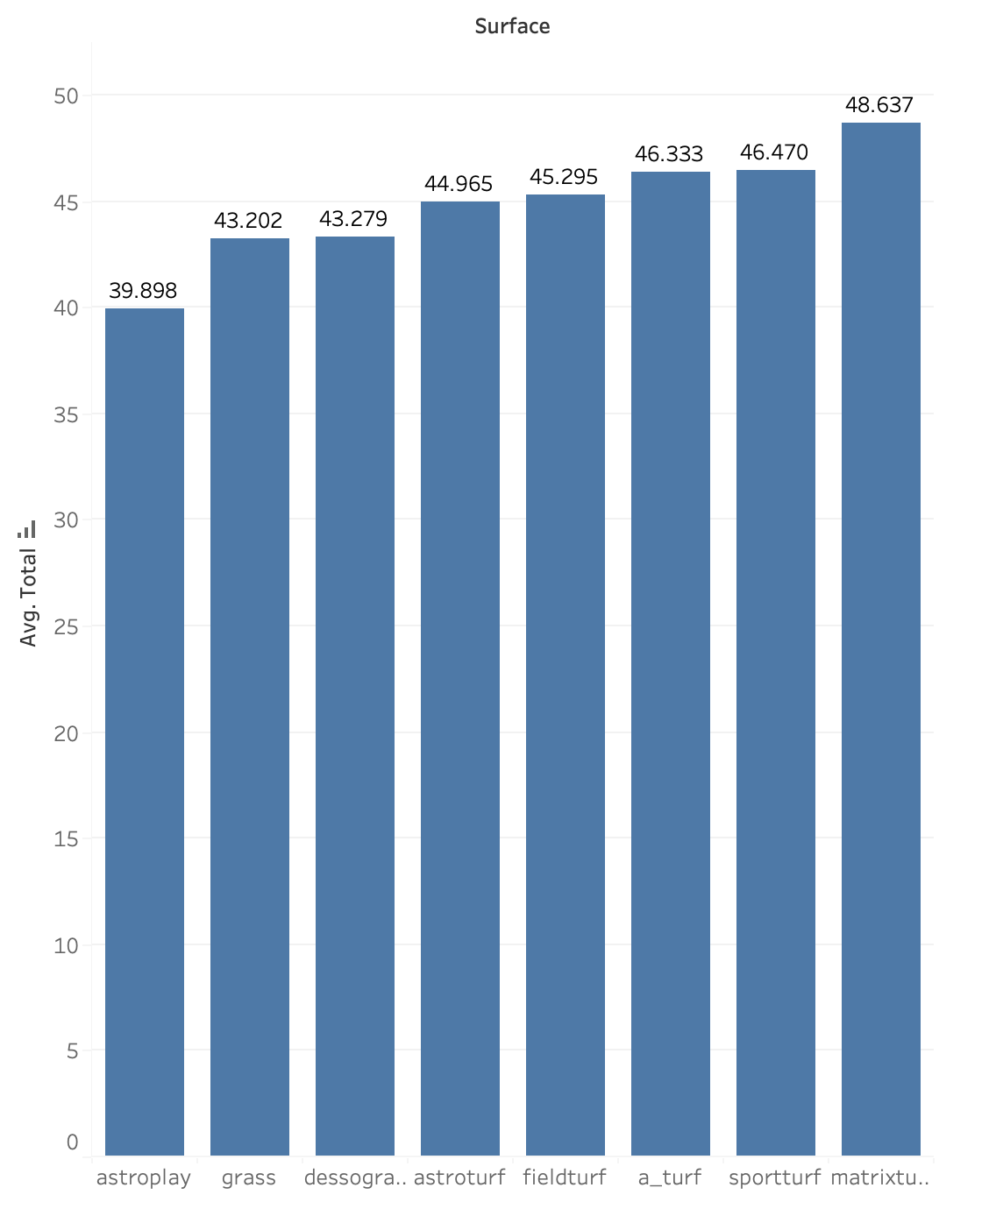
Key Findings: Settling the Grass vs Turf Debate
NFL owners claim playing on turf creates higher scoring games, which in turn are more interesting. Is there merit to these claims?
On the surface, yes.
Myth: Confirmed
Future insights:
How does field surface influence the likelihood of player injuries?
Compare the money lost on player injuries to the money gained from artificially boosting game score.
While turf make make games more interesting for viewers, my goal is to prove that injuries to players outweighs the impact of higher-scoring games.

Slide 11
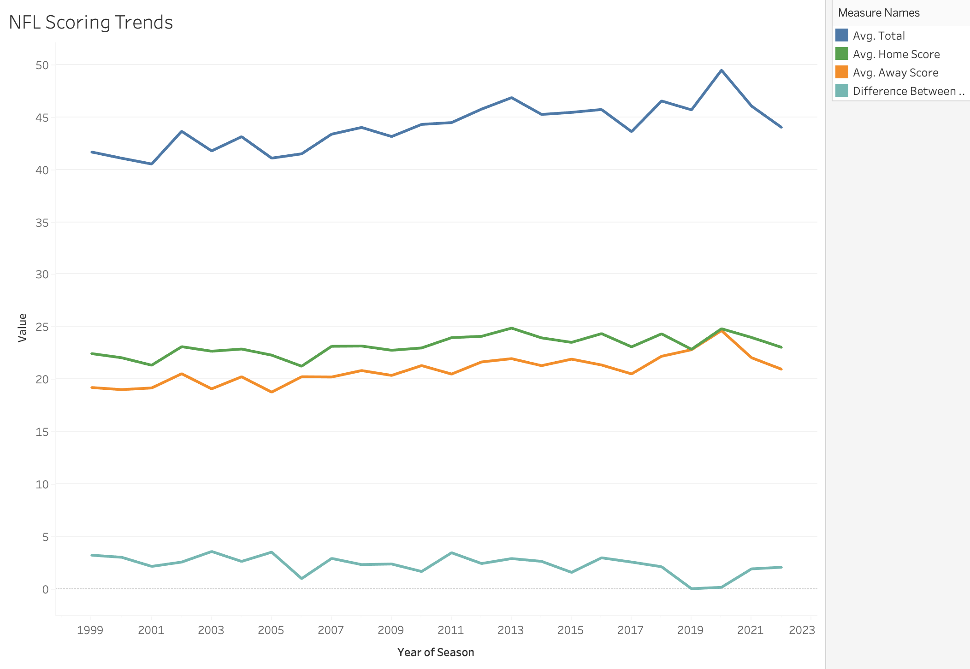
Key Findings: Impact of the 12th Man
Does playing at home truly give you a competitive advantage?
Vegas gives a 3-point bonus to home teams.
The difference between home and away score varies by year, but is consistently around 3 points.
Myth: Confirmed
Future insights:
Is there a way to determine where this advantage comes from? Is it all mental, or can climate and field surface be playing a role?

Slide 12
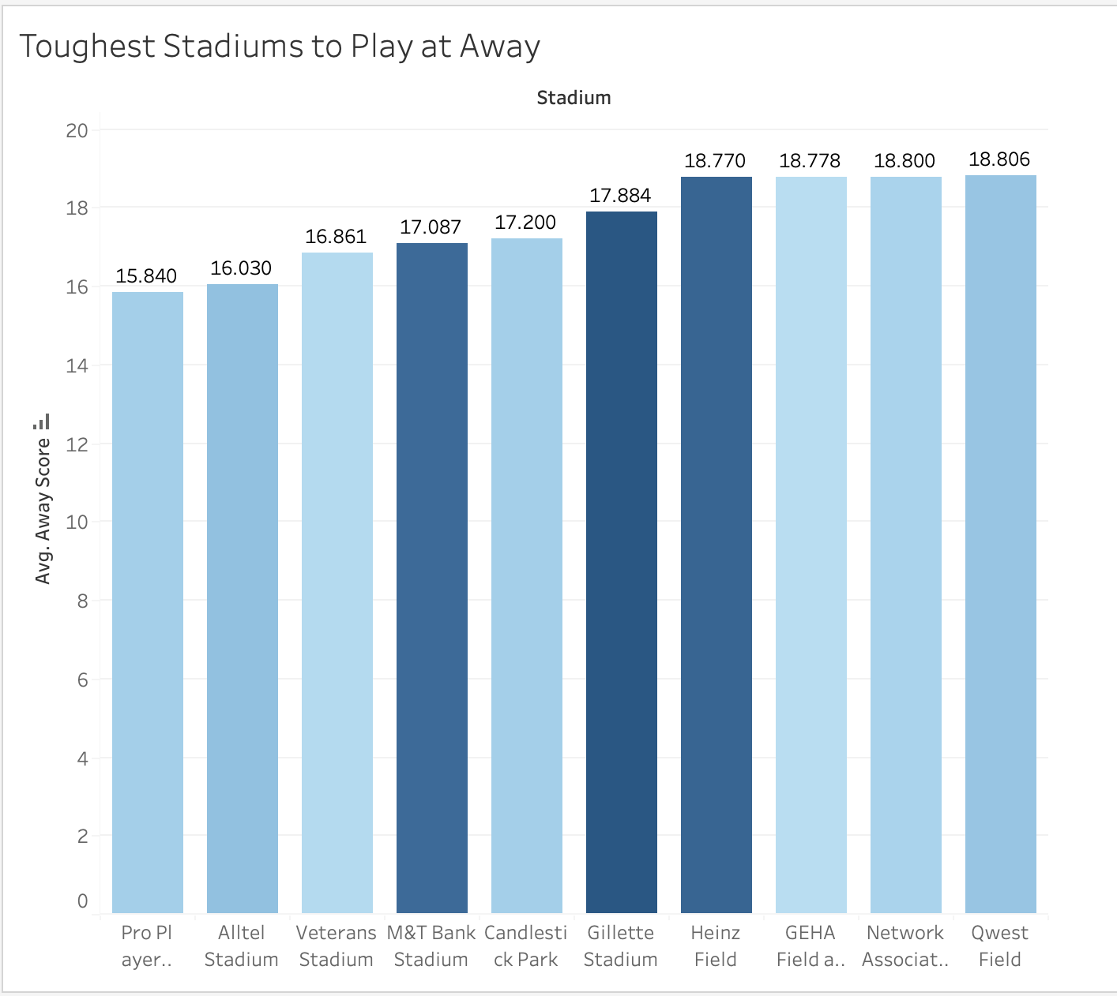
Key Findings: Toughest Stadiums on the Road
If playing at home gives you such a big advantage, who has the best home stadium?
Pro Player Stadium (Miami)
Alltel Stadium (Jacksonville)
Veterans Stadium (Philadelphia)
Makes sense how older stadiums have less points, since score in the NFL has gone up over time.
Very interesting takeaway: Team tend to score less on neutral sites (NFL Overseas, Temporary Stadiums)
Future insights:
Where does this advantage come from?

Slide 13
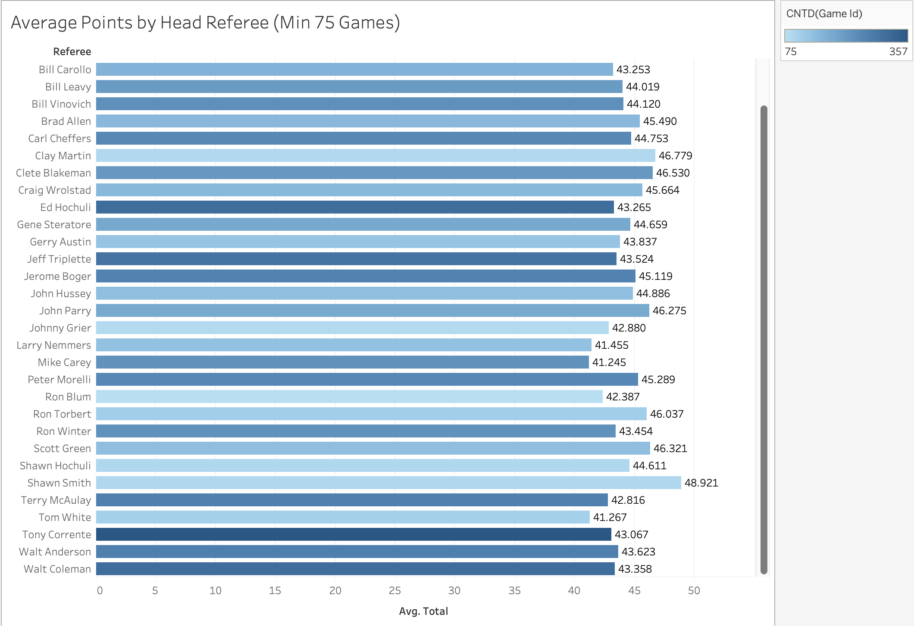
Key Findings: Refs as Silent Influencers
Fans often blame refs for influencing the game. Is there merit to these claims?
While points per game may differ depending on the refs selected for the game, this difference seems to be minimal.
Myth: Busted
Future insights:
While it seems like there is no difference across all refs, we can explore in the future how refs affect certain teams.

Slide 14
Model Creation and Analysis
Model Status
3 Models:
Home Score Predictor
Away Score Predictor
Total Score Predictor
Accuracy Metrics
Home RMSE: 10.627
Away RMSE: 9.355
Total Points RMSE: 16.355
Week 12 Accuracy
Win Predictor: 81%
Spread Predictor: 56% vs DraftKings
Useful Insights
Winner
Spread
Total Points
Team Points
Areas for Future Improvement:
1. Hone neural network to find optimal number of layers, depth and principal components.
2. Incorporate metrics from “Games” dataset, including weather, home and away, field surface and location.
Many of these have already been discovered through EDA, and now only need to be incorporated into the model.

Slide 15
Challenges and Next Steps
Biggest Challenges:
1. Accessibility of Data
2. Scraping data from ESPN
3. Data preprocessing and cleaning
4. Testing Model Parameters
Limitations:
Less game data at the beginning of the season, so less accurate.
Doesn’t consider team form (win and losing streaks).
No input for player injuries.
Not yet considering weather.
Next Steps
Build a user interface
Now that I can get predictions in my notebook, I can build a Streamlit app with my model so that others can get their predictions in an easy way.
Add more data
Weather, Players, Injuries, Stadium and Coaching
DraftKings Data Scraper
Automate weekly predictions.
Model Customization
Hone my parameters to find the build that most accurately predicts score.

